Slide 1
2.1 Exercise: NPK input price change with the policy editor
Alexander Gocht
Thünen-Institute, Braunschweig

Slide 2
Background: with and without market model
Input price changes can be applied in CAPRI for both task:
Run scenario with market model
Run scenario without market model
Input prices for mineral fertilizer are exogenous to the model

Slide 3
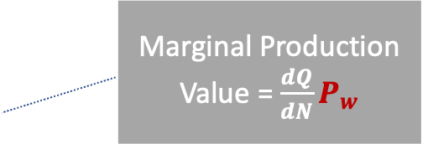
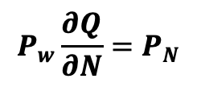
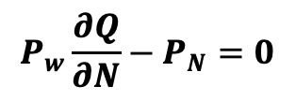

Economic Background
Demand
Production function
$$P_{W}$$
$$profit=P_{W}Q\left(N\right)− P_{N}N(Q)$$
Q
Supply=MC
$$P_{W}=Price of wheat$$
$$P_{N}=Fertilzer Price of nitrate$$
Q
$$Q=Production of wheat$$
$$N=Fertilzer Input$$
$$max\left(profit\right)=\frac{profit}{∂N}$$
Input N
$$P_{w}\frac{∂Q}{∂N}−P_{N}=0$$
Marginal value product (MVP)
Input price $P_{N}$
Marginal Production Value = $\frac{ⅆQ}{dN}P_{w}$
$$P_{w}\frac{∂Q}{∂N}=P_{N}$$
$$P_{w}={\frac{∂N}{∂Q}P}_{N}$$
Increase $P_{N}$
Input N

Slide 4
Important code parts

Slide 5
The objective function

Slide 6
Important code parts

Slide 7
Expectations
Yield
Supply
Price
Mineral fertilizer use
Income

Slide 8
Breakout session
We split randomly the group in groups of 3 participants
You have 30 min
run the scenario
fill out the quiz provided in the ppt
provide 1-2 slide additional results in the area of
Income, production, environmental indicators, trade
Please indicate one member of the group to present the group work at the end in about 2-5 min

Slide 9
Exercise 2.8. input price shock for fertilizer
Introduce a price change of +80% for mineral fertilizer
Find, modify and save the code snippet from the policy editor for “higher fertilizer prices”
Store the scenario from the wiki (or next slide) into the userScenc folder and run the model
Proof that the price shock was correctly translated into the model for the run without market model for Germany
Fill the cloze at the end of the presentation using the results for with market model from the zip file, where we assumed that fertilizer prices increase in all countries of the EU

Slide 10
Scenario in GAMS

Slide 11
Relevant tables in the exploiter
For supply, hectare and heard size, income and yield by activity see farm->Supply Details
For total price changes see -> table Prices
For Nitrate change see -> table environment->Nutrient balances -> Gross nutrient budgets

Slide 12
Cloze for Exercise 2.8 for Germany
Check that prices for fertilizer are increased in both runs, with and without market model, are 80%.
Without market model and with market model in bracket:
The change in supply for soft wheat is __%(__%) and for hectare -__%(__%). The price chance for soft wheat is __%(__%).
The change in mineral fertilizer for nitrate in sum for Germany is __%(__%), manure production in/decrease?
Production (supply) of pulses in/decrease by __%(__%), animal herd sizes in/decrease?
Farm income decrease by __%(__%)

