Slide 1
1.2 General Introduction to CAPRI
Alexander Gocht
Thünen Institute of Farm Economics, Braunschweig, Germany
19. September 2022

Slide 2
CAPRI: Introduction
Operational sc. 1999
Until 2013 Leadership: University of Bonn (W. Britz)
Now: Informal consortium with: UBonn/EuroCARE, Thünen, SLU, EU-JRC, UPM, WR, RURALIS, Swiss Ministry, HU-Berlin, Open-source community
Modern IT infrastructure: model solution in GAMS, model interface in Java and model/data distribution through SVN
Continuous financial support by the European Commission (DG-AGRI, DG-RTD and JRC) and some national agencies (Germany, Norway, Sweden, Switzerland)

Slide 3
Brexit
2000
CAP-STRAT
New MS
Spatial trade model
Exploitation tools
2009
CAPRI-RD
More countries
Pillar II
2017-2020
SUPREMA
Multi-model approach
Meta-platform
2004
CAPRI-Dynaspat
Spatial down-scaling
GUI
2013
TRUSTEE
Climate change
GHG
Global land-use
Water use
CC adaptation
20th Anniversary
GHG Mitigation
CAP 2014-2023 (greening)
Trade reforms (FTA)
Modulation
Sugar reform
GHG permits
CAP Mid-Term Review
Dairy reforms
Agenda 2000
CAPRI
1st Operational version 1999
Model development
and
topics analysed
follow policy challenges

Slide 4
Model types and classification
Product/agent coverage:
partial equilibrium / general equilibrium
supply / market models
Spatial coverage and representation:
global / national / regional models, regionalized models,
net trade / spatial representation
Representation of time:
comparative static / recursive dynamic / fully dynamic /ex-ante, ex-post
Source of parameters:
econometric models / synthetic models
Representation of chance:
Stochastic / deterministic models
….

Slide 5
CAPRI CAPMOD – core characteristics
Global, comparative static, partial equilibrium model for primary and secondary agricultural commodities
Designed for ex-ante impact assessment
European focus:
EU, Norway, Turkey and Western Balkans are covered by regional/farm type programming models which deliver detailed results, 1x1 km downscaling component for EU27
CAP premiums and market instruments well represented
Regional and commodity coverage of global, spatial trade model targeted to analysis of EU agri-food policy questions
Rather unique combination of spatial global trade model with regional, aggregate programming models based on sequential calibration – allows for a wide range of applications

Slide 6
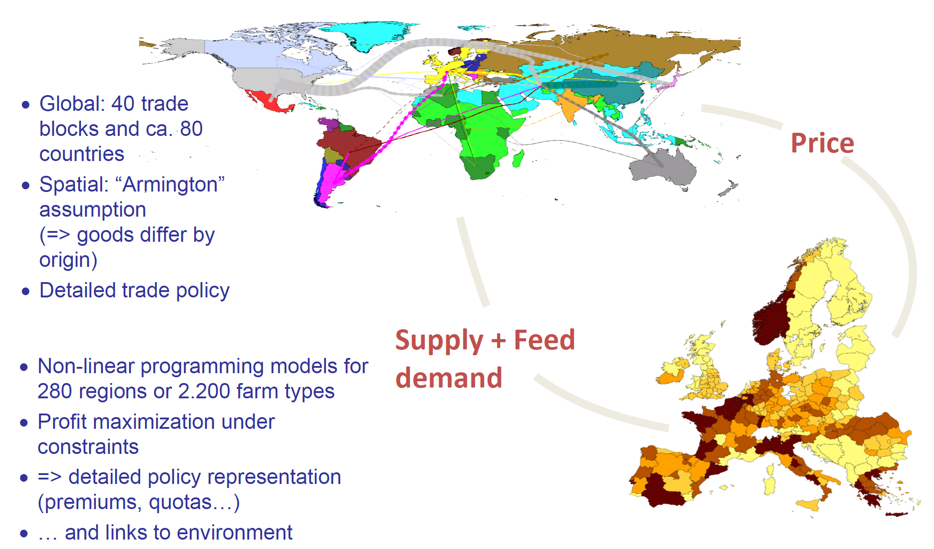
www.capri-model.org

Slide 7
CAPRI CAPMOD – Architecture
Policy problem
Scenario
Definition
(GAMS)
Simulation engine GAMS
Baseline (agr. world in 2030/2050)
Post-model Processing GAMS
Consulting
Analysis (GUI, Java)
Policy problem

Slide 8
CAPRI CAPMOD – Scenario definition
At the core of the art of economic modelling:
Policy instruments typically not easily mapped into “shocks” for economic model
Requires a good understanding of policy instruments, economic theory and profound knowledge about the structure of the model
Nevertheless: Subjective element will remain high! Careful communication with clients necessary and is very helpful

Slide 9
CAPRI CAPMOD –Scenario definition
Farm policy
Premiums (BPS,VCS ..)
Environmental standards (N Limits)
Opt-in measures (Pillar II)
Border/market policy
Tariffs TRQs
Intervention …
Other Population, GDP
Exchange rates
Input prices
Technical progress
Biofuel mandates, CO₂Pricing
Scenario
Definition
(GAMS)
Notes:
Scenario definition often one of the most problematic parts of the process: how to map

Slide 10
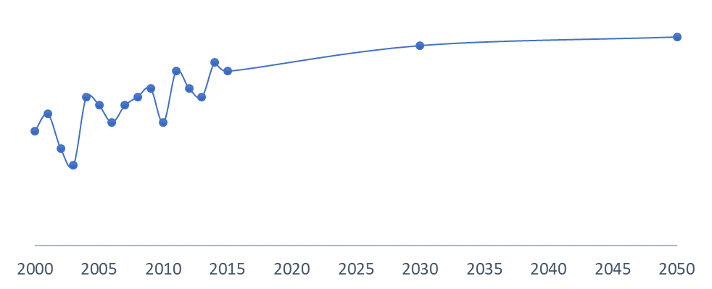
Scenario analysis: baseline
The baseline provides a reference or business as usual scenario for ex-ante assessment
The CAPRI baseline projects a high number of variables for each regional unit
ex-post data
projection period
simulation years

Slide 11
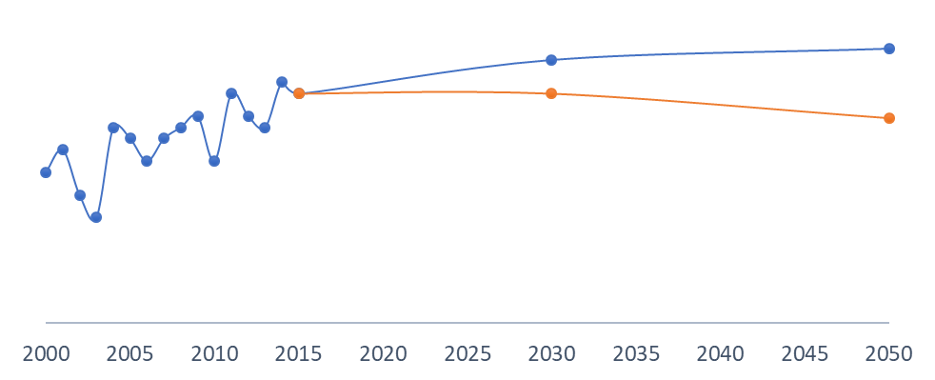
Scenario analysis: policy impact assessment
Assuming that the baseline is the picture of the world if everything goes on just as expected, then what if a new policy is implemented?
impact
Impact is measured as difference from the baseline in the chosen simulation year
ex-post data
projection period
simulation years

Slide 12
CAPRI CAPMOD – Architecture
Policy problem
Scenario
Definition
(GAMS)
Simulation engine GAMS
Baseline (agr. world in 2030/2050)
Post-model Processing GAMS
Consulting
Analysis (GUI, Java)
Policy problem

Slide 13
CAPRI CAPMOD – Architecture: Simulation engine
Sequential
Calibration:
Iterate till convergence
Prices
Supply module
Global
trade module
Quantities
(Europe)

Slide 14
CAPRI CAPMOD – Supply module: MP-Models
400x400x1900
= ~0.75 Mio variables/equations
CONOPT, parallel solve, ~30 sec
for 2500 models
Max revenues – costs
(Leontief + dual cost function)
s.t.
Feed requirements
Nutrient requirements
Land balances/supply Balances non-tradeables
Policy restrictions Environmental restriction
I/O coefficients
Supply
Feed demand
(bulks)
Areas
Herds
Yields
Input demand
GVA
Prices
Farm policy
instruments
280 NUTS 2 2500 Farm types (EU 28)
EU28 / Norway / Western Balkans Turkey

Slide 15
CAPRI CAPMOD – Architecture: Simulation engine
Sequential
Calibration:
Iterate till convergence
Prices
Supply module
Global
trade module
Quantities
(Europe)

Slide 16
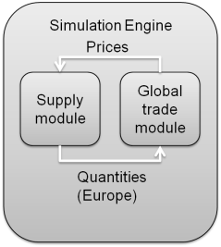
CAPRI CAPMOD – Global Trade Module
CNS ~40.000 x 40.000
Highly non-linear
CONOPT, parallel pre-solves, ~5 sec with good starting point
Comparative static Spatial
Multi-Commodity Model
(Find fix point
in global markets)
Armington assumption
Flexible function form
Well behaved parameterization
Exchange rates
Population/GDP
Taste shifts
Supply Final demand
Feed Processing
Prices (producer
/consumer)
Trade flows
Supply/Feed demand from supply module
Border Protection, EU market policies
~80 countries/country blocks in 40 trade blocks
Globally closed

Slide 17
CAPRI CAPMOD – Architecture: Simulation engine
Sequential
Calibration:
Iterate till convergence
Prices
Supply module
Global
trade module
Quantities
(Europe)

Slide 18
Comparative Static Equilibrium
Sequential iteration between the reg. supply and the market model:
Supply function of NUTS2 models is unknown (black)
Assume any supply function (red) in market model for EU East and EU West
Starting with some price, simulate supply with NUTS2 models in EU E-W
Calibrate the assumed supply function to that point
Solve supply + demand in market model simultaneously for new price
Iterate until convergence…
s’
s’
p
s
s
p₀
d
q₀
q

Slide 19
CAPRI CAPMOD – Architecture
Policy problem
Scenario
Definition
(GAMS)
Simulation engine GAMS
Baseline (agr. world in 2030/2050)
Post-model Processing GAMS
Consulting
Analysis (GUI, Java)
Policy problem

Slide 20
CAPRI CAPMOD –Post Model Processing
Support of result analysis
Aggregation over scales/products/activities
Decomposition: yield response, behavioral functions market model
Economics
Farm income indicators (activities/regions)
Welfare analysis
CAP budget, CAP instruments
Environmental indicators
Gaseous emissions
N,P,K balances
GHG inventories (IPCC for Europe, emission coefficient based approach for regions in market model)
Energy use in European agriculture
Spatial downscaling

Slide 21
Core tasks in CAPRI
Gams-file | Task | Key input file(s) | Key output file(s)
COCO1 | Prepare national database | [Raw data] | coco\coco1_output
COCO2 | Finish national database | coco\coco1_output | coco\coco2_output
Compile_rdp_data | Compile RDP data | [Raw data] | policy\rd_budget
CAPREG | Build regional time series | coco\coco2_output policy\rd_budget | capreg\res_time_seriesBBMS
CAPREG | Build regional database | capreg\res_time_seriesBBMS | capreg\res_BBMS
Prepare_faostat_database | Prepare FAOSTAT database | [Raw data] | fao\faodata
Global_database | Build global database | fao\faodata? | global\fao_agg_BB_new
Est_emission_factors | Estimate GHG emission coefficients | global\fao_agg_BB_new capreg\res_BBMS [Raw data] | envind\ghg_emission_trends
CAPTRD | Generate trend projection | capreg\res_time_seriesBBMS | baseline\trends_BBYY
CAPMOD | Baseline calibration market model | capreg\res_BBMS baseline\trends_BBYY global\fao_agg_BB_new | baseline\data_market_BBYY baseline\data_uvagBBYY
CAPMOD | Baseline calibration supply models | capreg\res_BBMS baseline\trends_BBYY baseline\data_uvagBBYY | baseline\pmppar_NBBYY
CAPMOD | Run scenario with market model | baseline\pmppar_NBBYY baseline\data_market_BBYY | capmod\res_NBBYYscen
CAPMOD | Run scenario without market model | baseline\pmppar_NBBYY baseline\data_uvagBBYY | capmod\res_NBBYYscen
CAPMOD | Run scenario with only market model | baseline\data_market_BBYY | capmod\res_NBBYYscen

Slide 22
CAPRI – data sources
EUROSTAT: market balances, acreages, herd sizes, yields, slaughtering statistics, Economic Accounts for Agriculture, household surveys, macro-econ indicators, regional agricultural and land use statistics, farm structure survey, standard gross margins ..
FAOSTAT: supply utilization accounts, trade matrices
AMAD: tariffs
FADN/FSS: for the farm type module and estimation of parameters like input allocation
Policy: WTO commitments, CAP policies, FTAs ..
Notes:
AMAD- Agricultural Market Access Database

Slide 23
CAPRI – data sources: input from other models
Data base / parameterization:
GTAP/DynaClue: land supply curve
MITERRA/GAINS: nitrogen emission factors
Baseline:
AGLINK/COSIMO: market balances, prices
PRIMES and POLES: bio-energy
IMPACT and GLOBIOM: long term trends

Slide 24
Wrap-up: Some not so nice features
Most of the work is on the database “consolidation”
black box feeling, high learning costs
One approach fits all (template approach)
Long execution time: iteration between the modules time consuming or sometimes does not converge

Slide 25
Wrap-up: Some nice feature
full representation of the ag. sector
technological details
real units: number of animals, hectare, tones
TRQ, import tariffs, …
Many economic and environmental indicators

Slide 26
Questions? Comments?
See also www.capri-model.org

