Slide 1
CAPCGE The regional CGEs of CAPRI
Wolfgang Britz with material from Hasan Dudu
Institute for Food and Resource Economics, University Bonn

Slide 2
Content
General characteristics
Supply side
Households:
Demand function, saving
Income generation and income tax
Net migration
State
Investment
Market clearing

Slide 3
Why CGEs for CAPRI?
Pillar II does not only target agricultural sector
Importance of agriculture for employment, income and up- and downstream industries can be still high in some rural regions of the EU
The CGEs are a tool which can be used independently from the supply and market part of CAPRI, e.g. to analyze impact of the structural funds
Closed accounting across sectors based on CGEs

Slide 4
Why CGEs for CAPRI?
Funds available via EU Framework project CAPRI-RD 2009-2013
Main contributors:
Marc Müller and Emanuele Ferrarri for EU SAMS, Hassan Dudu for Turkey, Ales Kuhar for Croatia
Hannu Törmä and Kazia Zwazalinska for conceptual template and GEMPACK version, building on REGFIN
Kazia, Peter Witzke, Janet Dwyer and others for mapping Pillar II instruments to shocks for CGE
Torbjoern Jasson and Wolfgang Britz for link CGE-PE
Wolfgang for GAMS version, including some conceptual changes, and GUI implementation

Slide 5
General characteristics
Single country CGEs for EU MS, Turkey and Croatia
Trade represented by export demand and import supply functions (open economy), no bi-lateral trade or global closure in opposite to GTAP derived CGEs
11 sectors (SAMs features some more)
Regionalized to NUTS2 regions (ca. 250 regions for EU)
Comparative-static (ex-post or in future time points, baseline aligned to CAPRI)
As usual in CGEs, quantities are expressed in constant monetary units (not physical ones)

Slide 6
Some additional features
Endogenous unemployment (wage rate curve or fixed wage rate) as option to model the labour market
Total capital stock can be endogenous
Net migration function (regional population size not fix)
Different closures already built in model code
Post model reporting with welfare analysis
Focus on linking model (shocks) to Pillar II expenditure data
Can be linked to regional programming models of CAPMOD

Slide 7
IT solution
Realized in GAMS, similar version also available in GEMPACK
GAMS version in levels, GEMPACK version mostly in first differences
GAMS version normally solved as CNS (= constrained system of equation), MCP version available (but PATH is typically more sensitive to scaling)
Can be used in stand-alone mode or linked into CAPRI
GUI linked into CAPRI GUI
GAMS code, data and results part of CAPRI trunk in the SVN server

Slide 8
Key differences CGEs and PEs
CGEs cover all sectors of the economy, PEs focus on specific ones
CGEs cover all primary factor (markets), PE none or only land (and than often as a fixed resource)
CGEs describe income generation and use, PEs typically only a part of use
CGEs link saving and investments
CGEs comprise the state budget
CGEs are typically not written in physical units
CGEs are typically expressing policy interventions as ad-valorem wedges
CGEs have typically a coarser production differentiation

Slide 9
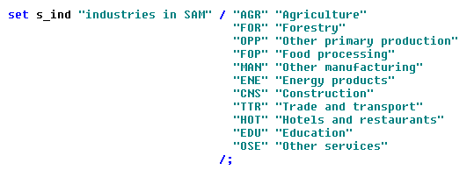
Core sets in REGCGE
Sectors = products (diagonal, single output sectors)

Slide 10
Supply side
Price takers, constant returns to scale => average equal marginal costs => zero average profits => profit max supply quantities undefined (!), only cost minimal input mix can be derived
As usual in CGE, explicit representation of technology (not a dual profit function from which supply functions are derived):
Top level CES nests substitutes between Value Added (= aggregate of labor, capital and land) and Intermediate Input Aggregate => input coefficients per unit of output not fixed
Intermediate demand broken down to from regional origin, from rest-of-nation and from imports, to capture regional multipliers, CES substitution according to input coefficient price indices for the three origins

Slide 11
Supply side
CET (= transformation function), profit maximal distribution of output to region, rest-of-nation and exports (different types of product delivered)
Equally standard in CGE: as models does not comprise an objective (CNS: # of variables equal to # of equations), optimal input demand and optimal CET share expressed via FOC

Slide 12
Production function
Gross Production Value
Value Added
Intermediate Input Demand
CES
Land
Labor
Capital
Regional
CES
CES
Rest of nation
ROW
Inp 1
…
Inp n
Leontieff
Leontieff
Inp 1
…
Inp n
Leontieff
Inp 1
…
Inp n

Slide 13
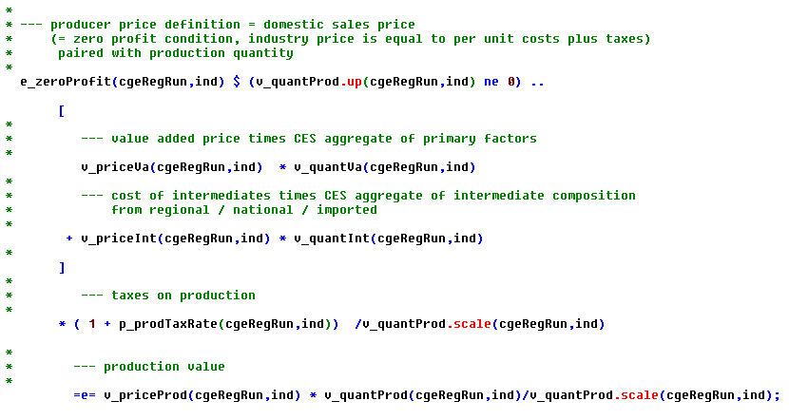
Zero (average=marginal) profits
region
industry
Value added cost (primary factors)
Costs
for intermediates

Slide 14
VA-demand
Top level nest: Substitution between VA and intermediates
VA demand = production capacity, can be reached by different
compositions of the primary factors

Slide 15
Value added exhaustion
Price index “average VA price”
VA aggregate = production capacity
Total primary factor
cost (w times x)

Slide 16
Primary factor demand
Total VA demand = production capacity
Primary factor
Factor demand
quantity
Policy intervention:
subsidize or tax
on factor use, ad valorem

Slide 17
Intermediate demand exhaustion
Average price of intermediates for industry ind from origin dest
Leontief, fixed ind1
shares
w time x = total intermediate cost

Slide 18
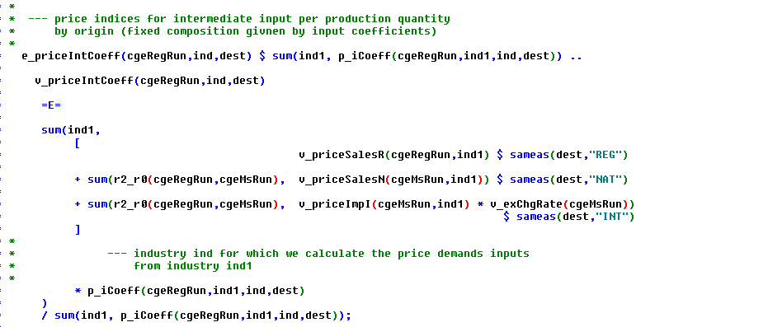
Intermediate price by destination
price according to
origin
Leontief, fixed ind1 shares

Slide 19
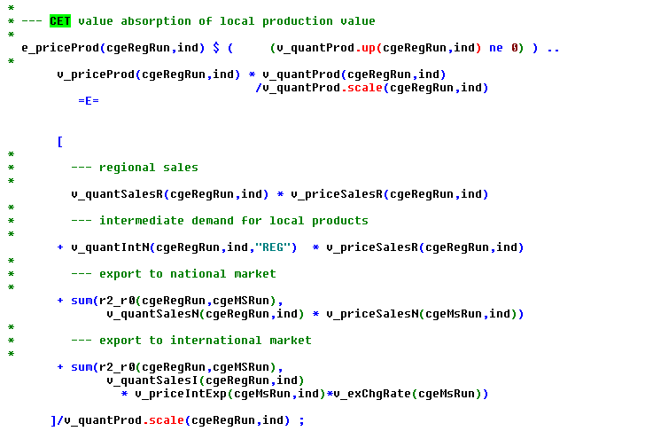
Production value exhaustion
Production value
Revenues from
selling to different
destinations

Slide 20
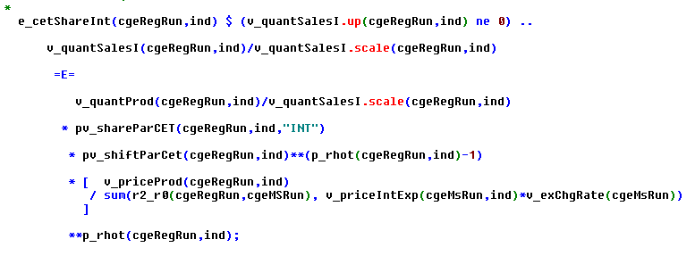
Distribution of output (CET)
Sales for export
Price relation between average producer price
and export price, if export price increases,
export (share) increases
Two identically structured equations for regional and rest-of-nation

Slide 21
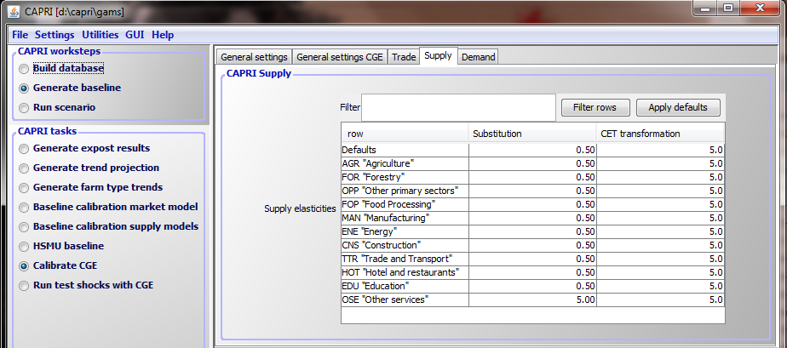
Parameters via interface

Slide 22
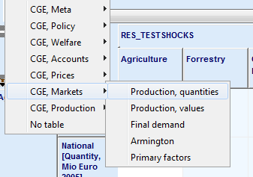
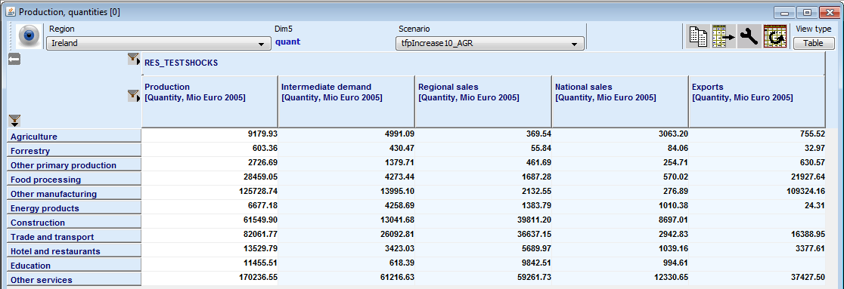
Production quantities and CET

Slide 23
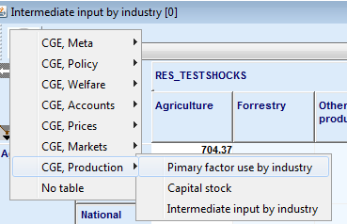
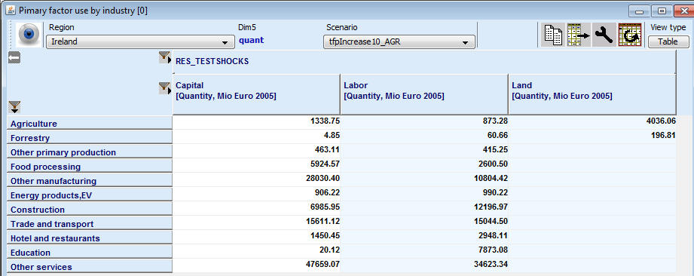
Supply side: Primary factor use

Slide 24
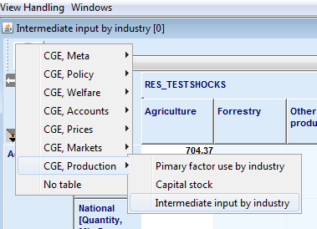
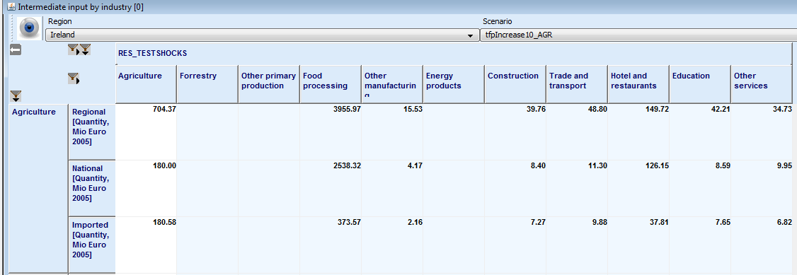
Intermediate input demand

Slide 25
Households
One regional aggregate household (= no household types)
The household owns the primary factors and receive therefore the primary factor remuneration (besides borrowing from abroad the only income source in the economy!)
Household are utility maximizers
CD utility (= fixed expenditure shares) for savings and final demand
Final demand according to LES
No utility changes from working more or less
Households pay taxes on primary factor income and receive transfers from local government, plus might borrow / put money aside (= not invested!)

Slide 26
Households
Factor Income
Household Income
Consumption
Linear Exp Sys
Cobb-Douglas
Comm 1
…
Com n
Taxes/Subsidies
Income Tax
Sales Tax
Regional
National
CLOSURE
Net Saving
Saving
CLOSURE
Borrowing
CLOSURE
Subsidies

Slide 27
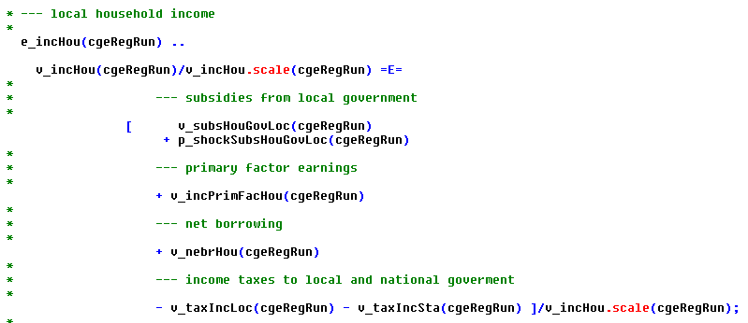
Households, income and its exhaustion

Slide 28
Households, primary factor income
Households are assumed to own the production factors
Link to supply side: primary factor use in industries
Prices paid by industries (need not be identical,
depends on factor market structure)

Slide 29
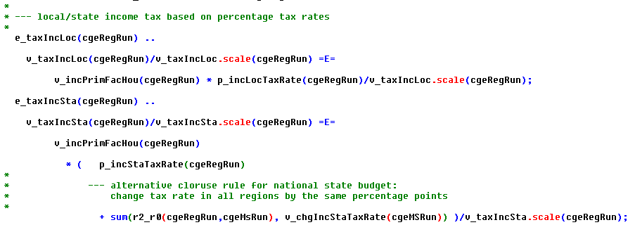
Households, income taxes
Model distinguishes between national and regional income tax
National tax rate might differ between regions
Change in national tax rates (= possible closure for state budget) by updating regional specific national tax rates

Slide 30
Households, final demand (1)
LES – Linear Expenditure System
Stone-Geary Utility function (CD with constant term), γ = demands independent of prices and income, β = marginal budget shares
Leads to the following demand functions:

Slide 31
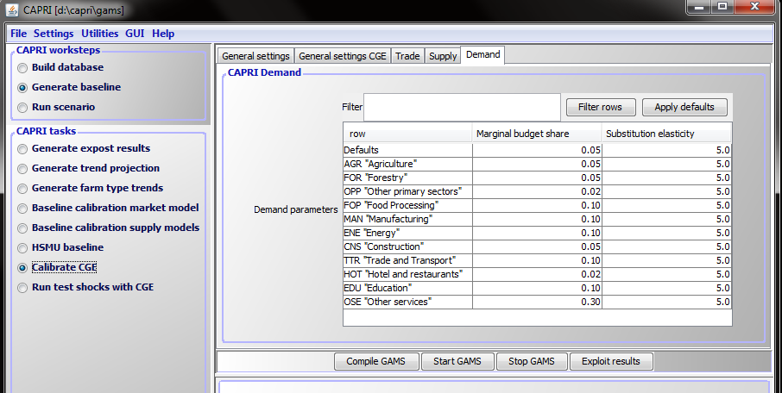
Households, final demand (2)
β = marginal budget shares

Slide 32
Households, final demand (3)
Linear Engel curves (= marginal budget shares fixed)
No inferior commodities (marginal budget shares β >0)
Only gross complements (a price increase in p1 reduces non-committed income and therefore decreases ALL demand quantities)
Only inelastic demand
Calibration: determine commitments such that quantities are demanded at prices and income of calibration point (see regcge\cal_les.gms)

Slide 33
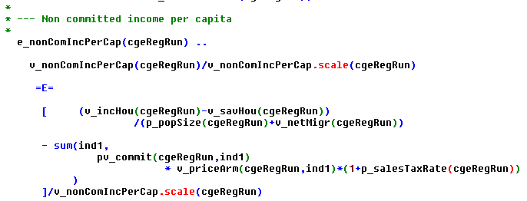
Households, final demand (4)
Total value of final demand per head
Average price for product ind1 (from regional, rest of nation and imports)
Commitments = constant terms of demand function

Slide 34
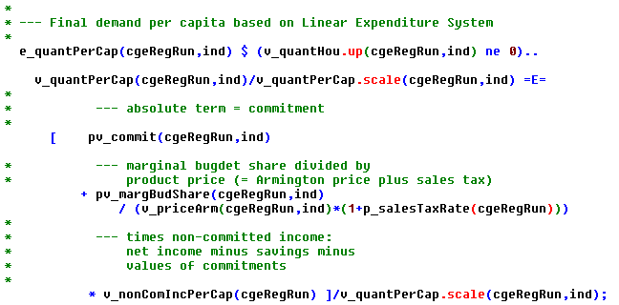
Households, final demand (5)

Slide 35
Net migration (1)
Population size is a linear function of regional per capita income and employment rate, compared to national averages
Updates also the available labor force in the region
Correction term ensures that sum of net migration over regions is zero

Slide 36
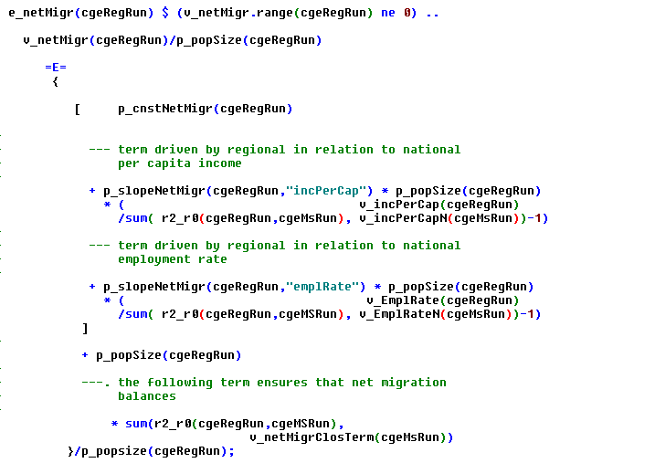
Net migration (2)
Relative difference ... between regional
and national income
per capita
... of employment
rates

Slide 37
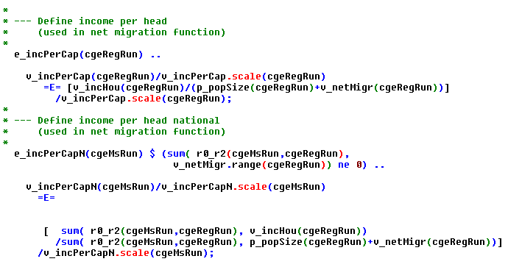
Per capita income, regional and national

Slide 38
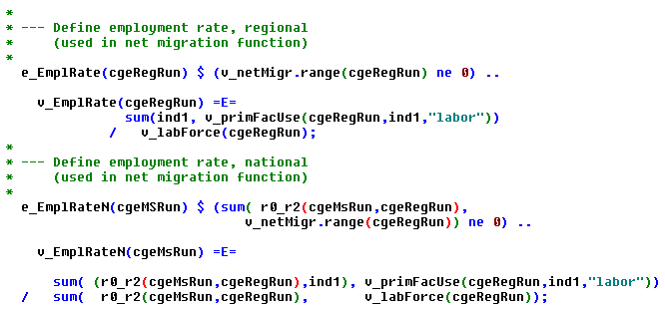
Employment rate, regional and national

Slide 39
Where to find results in the interface
Only consumption
generates welfare
Attention: An increase in income does not necessarily imply I am better off … beware of price changes

Slide 40
Welfare analysis households
Deflated with consumer price index
Money metric per capita

Slide 41
Government account
Income Tax
CLOSURE
Borrowing
Savings
Subsidies to HHs
Factor Tax
CLOSURE
Cobb-
Douglas
Prod. Tax
National Gov't
Loca
Gov't
Consumption
Sales Tax
EU Budget
Fixed Budget Share
Investment Tax
Com. 1
…
Com. N

Slide 42
Regional government, income and spending
Taxes on regional primary facctor earnings
Share of
national
taxes

Slide 43
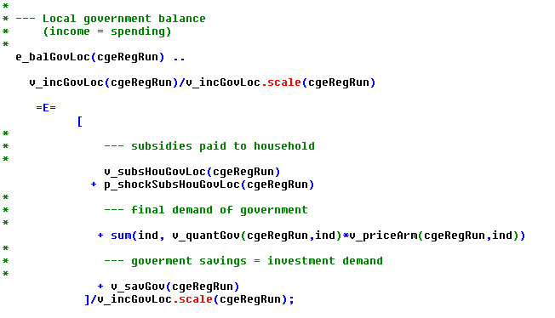
Regional government, balance
Regional Household
Final demand

Slide 44
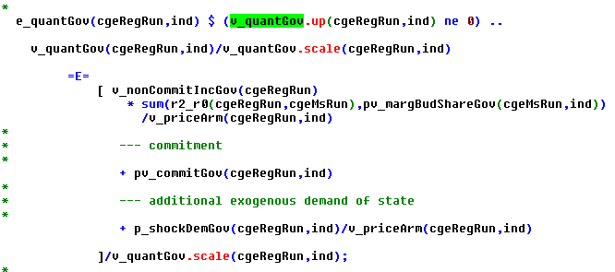
Regional government, final demand
Marginal budget shares
LES, as for households

Slide 45
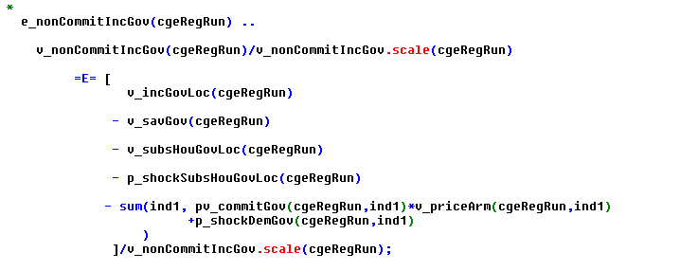
Regional government, final demand
Similar to household: income minus saving minus exogenous
demand quantities = non-committed income
Currently, marginal = average budget shares in calibration point,
See regcge\regcge_ini.gms

Slide 46
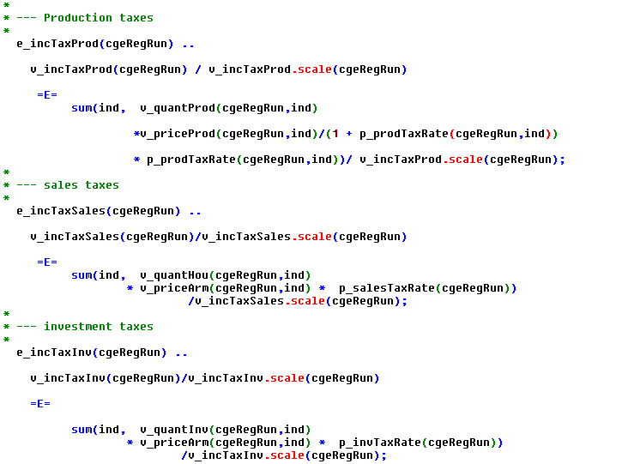
National government income (1)

Slide 47
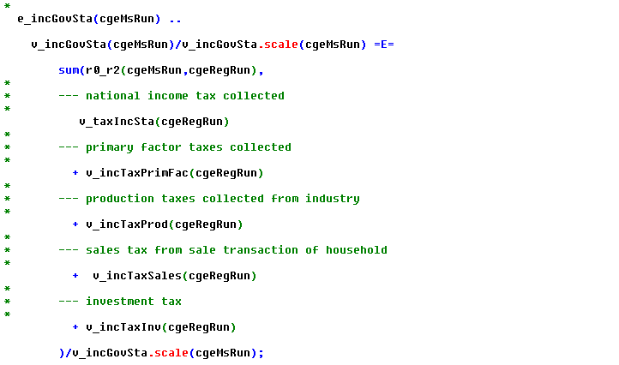
National government income (2)

Slide 48
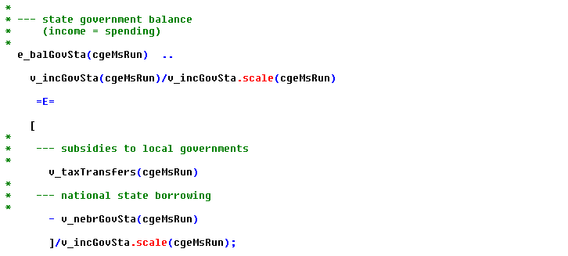
National government balance
National government has no own consumption, sole distribution agency

Slide 49
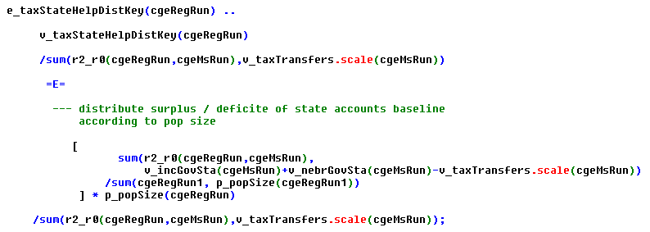
Tax transfers to local government

Slide 50
Government account in interface

Slide 51
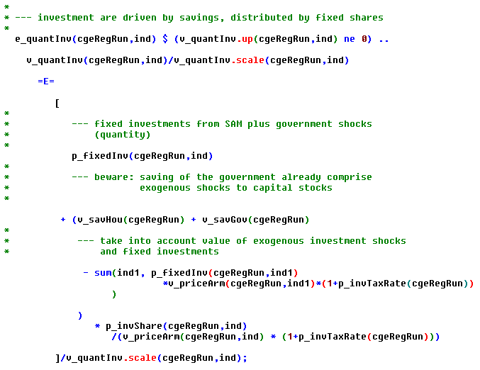
Investments
Investments = savings at regional level, total investment distribution with fixed shares

Slide 52
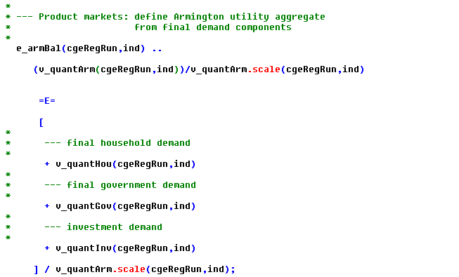
Total final demand
Total final demand in utility equivalents (= utility of Armington CES demand system)

Slide 53
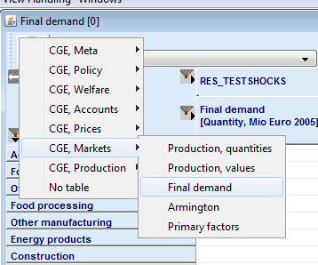
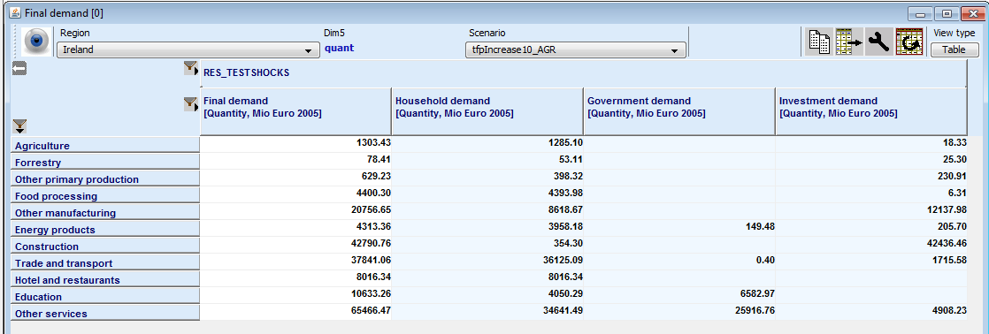
Final demand in interface

Slide 54
Factor markets, capital
Different closures possible, can be selected by interface
Options for capital market:
Short run: capital stock of industry is fixed => investment changes have no impact on capital stock!
Fully mobile capital:
With fixed capital stock (tractors move into service sector), but investment changes have no impact on captial stock, classical long run in CGEs, but economic Interpretation unclear
Updated with investment, as before, by changes in saving (= investment) affect total capital stock
Only depreciated part of capital is mobile, DPSV

Slide 55
Capital market, DPSV
DPSV Dixon, P. B., B. R. Parmenter, J. Sutton and D. P. Vincent(1982), ORANI: Multisectoral Model of the Australian Economy. Amsterdam: North Holland
Capital stock in the industry is depreciated (in calibration point: gross investments = depreciation, no change in capital stock)
New investment into a sector’s capital stock depend on the relation between returns to capital and investment costs
Returns to capital are not fully aligned between sector (survival of old, industry specific stock, “prudency” of investors)
(Attention: behavioral assumption of risk aversion [“prudency”] is not reflected in welfare accounting => leakage, dubious results possible)

Slide 56
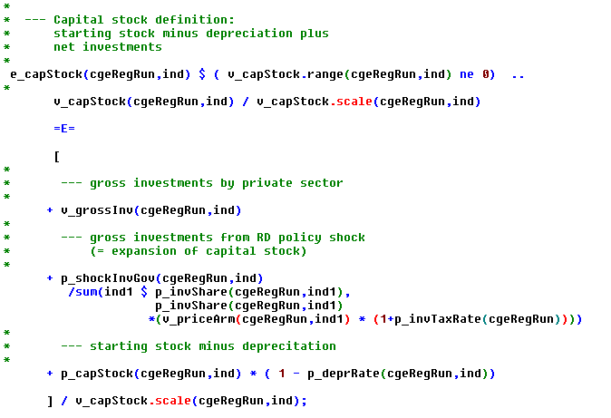
Capital stock definition
What drives these decisions?

Slide 57
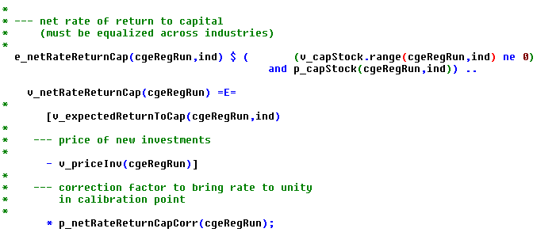
Expected net returns to capital
Expected net returns to capital (= net of depreciation and costs of investments)
Investors distibute savings such that expected returns across
Industries are equal

Slide 58
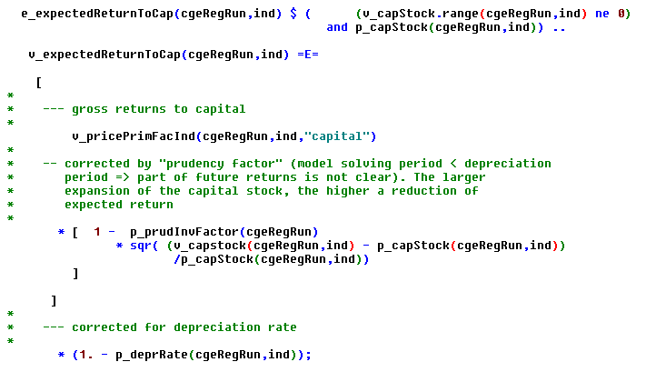
Expected returns by industry

Slide 59
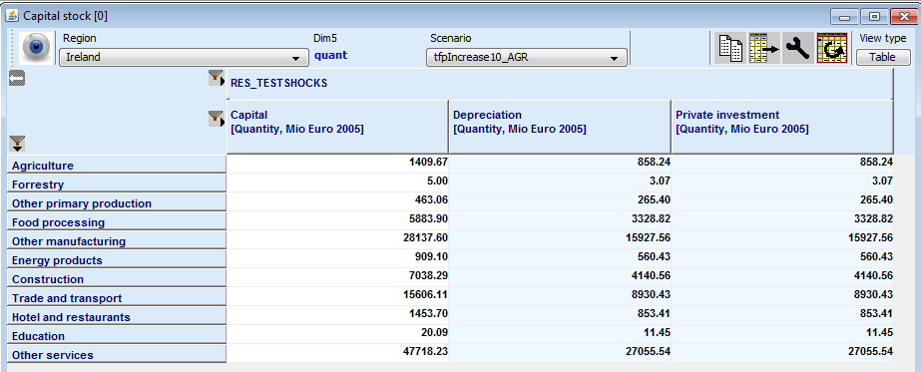
Capital stocks

Slide 60
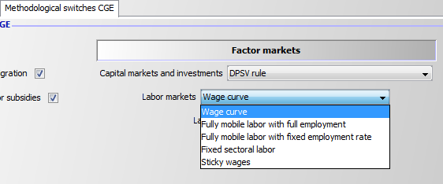
Labor market
Similar options as for capital:
Very short run: sector labor is fixed (more for testing)
Fully mobile with full employment (= does not recalibrate, calibration point comprises unemployment)
Fully mobile with fixed employment rate
Wage curve: wages and employment rate endogenous (attention: behavioural equation is not in welfare analysis!)
Sticky wages: wage rate fix, employment rate endogenous

Slide 61
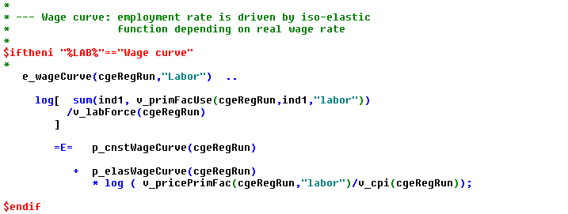
Labor market, wage curve
Employment rate is a function of the wage rate: the higher the wage rate, the higher the employment rate

Slide 62
Market clearing for products
Market clearing equations are physical balances, measured in constant €
Market clearing equations drive market clearing prices
Competitive markets, i.e. marginal costs equal marginal willingness to pay, no market power

Slide 63
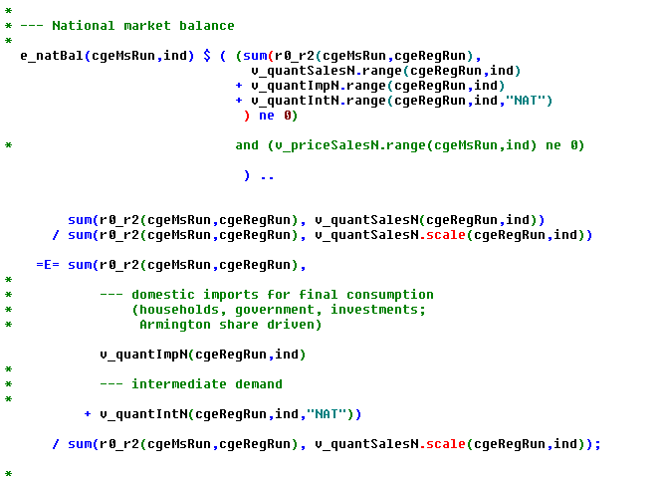
Market clearing rest-of-nation
Rest-of-nation balance (= specific quality available in that market)
Sum of deliveries from regions
Final demand
Intermediate demand

Slide 64
Intermediate demand aggregates by origin
From region, rest-of-nation, imported
Leontief, fixed composition
Total use from dest by industry ind1

Slide 65
Final demand by origin
Share depends on aggregate price divided by price from that origin,
and parameters of the CES-utility function
(two identical equations for rest-of-nation and regional

Slide 66
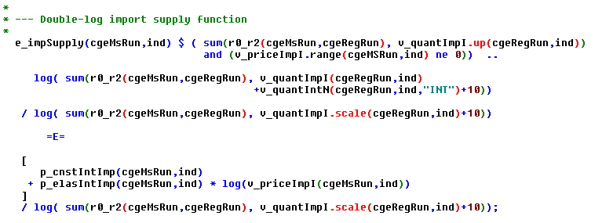
Export demand and import supply

Slide 67
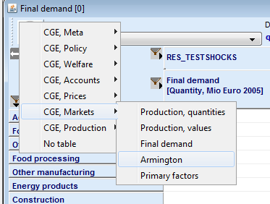
Markets in interface

Slide 68
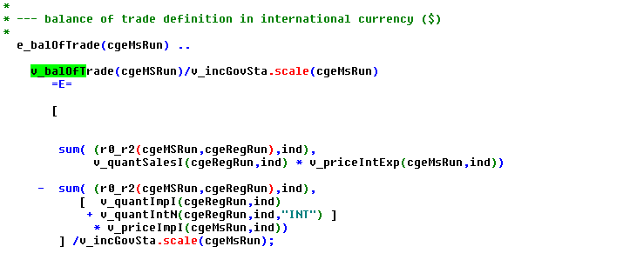
Macro-economic closure (1)
Balance of trade (value of exports – imports)
= current acount balance

Slide 69
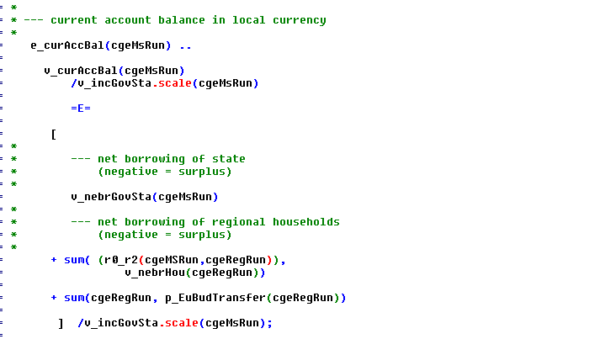
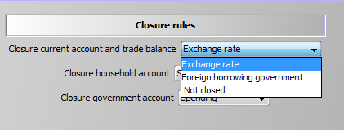
Macro-economic closure (2)
Current account balance: net borrowing of state of households
Closure:
Flexible exchange rate
or borrowing or not closed

Slide 70
Model solves
For larger countries, > 10.000 equations, partly non-linear => solution process can be tricky
Regcge\solve_model.gms:
Repeated solves
Expand bounds if vars are at bounds and bounds carry a marginal value
Add “slacks” to selected equations (= infeasibilities) and minimize via objective function
To save time, country models can be solved in parallel on several processors

Slide 71
Data and calibration
Main data source are national and regional SAMs (dat\regcge\crdSam*.gdx)
Additional data for regional population and exployment fom EuroStat
Parameters had been samples by Hannu and Kazia, now as default in CAPRINEW_DEFAULT.XML (e.g. substitution and expenditure elasticities)

Slide 72
Baseline
Main purposes:
Align production value, primary factor use and intermediate input demand for agriculture between the regional programming models and the regional CGEs
Update SAM entries to reflect population and GDP growth
Avoid curious tax rates

Slide 73
Baseline
Input SAM
CAPRI baseline
Other data
Map SAM entries in base year
to match structure of REGCGE
Test that base year SAM is balance
Shift balance items according to population/GDP
growth and CAPTRD results for agriculture
Balance SAM for ex-ante year
Determine behavioral parameters
Test model

